Slide 1

Overview of Algorithm
Department of BCA

Slide 2
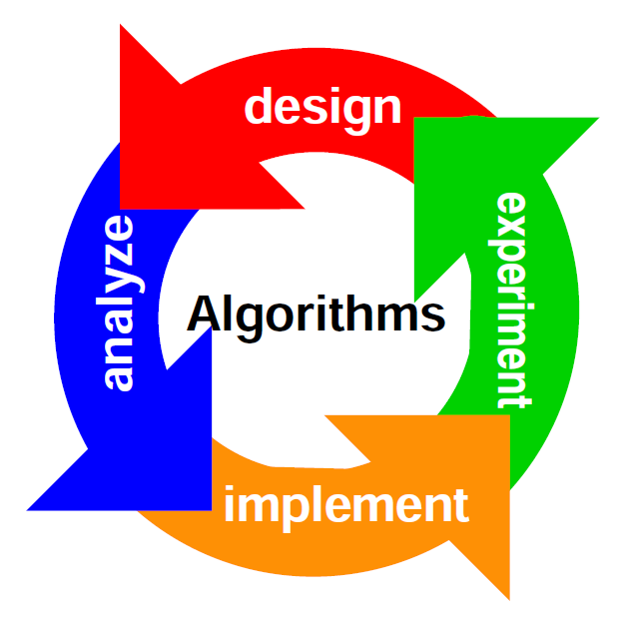
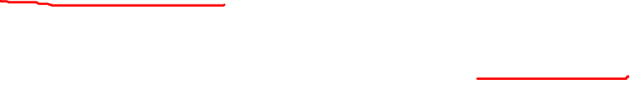
Algorithm
Algorithm is a step-by-step process.
An algorithm is a set of instructions designed to perform a specific task .
Algorithm refers to a set of rules/instructions that step-by-step define how a work is to be executed upon in order to get the expected results.

Slide 3
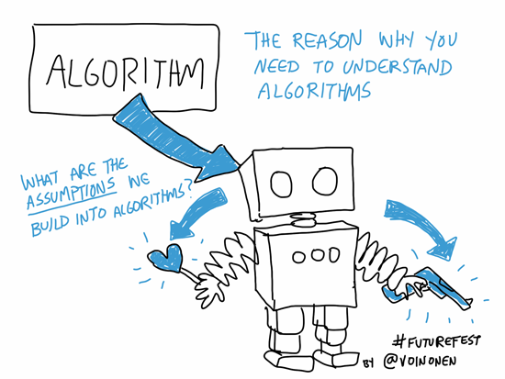
Some more words…
Well, I will say there’s a live example of algorithm who love to cook and love food as well. One of the most obvious examples of an algorithm is a recipe. It’s a finite list of instructions used to perform a task.
Notes
Mars is actually a cold place

Slide 4
1. It has a set of inputs 2. Steps are uniquely defined 3. It has finite number of steps 4. It Produces desired output
Characteristic Of An Algorithm

Slide 5
1.The inputs must be specified 2.The outputs must be specified 3.Definiteness 4.Effectiveness 5.Finiteness
5 things algorithm must have

Slide 6
Write an algorithm to post a letter to your friend​

Slide 7
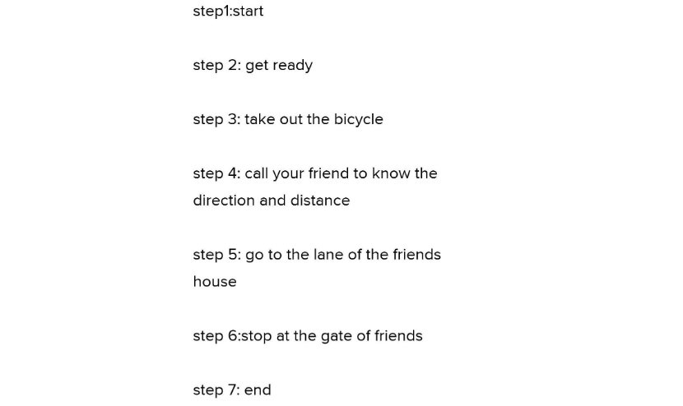

Slide 8
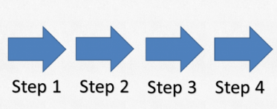
Step 1: Start
Step 2: Declare the variables name, address.
Step 3: Read values of name, address from the user.
Step 4: Display name, address.
Step 5: End

Slide 9
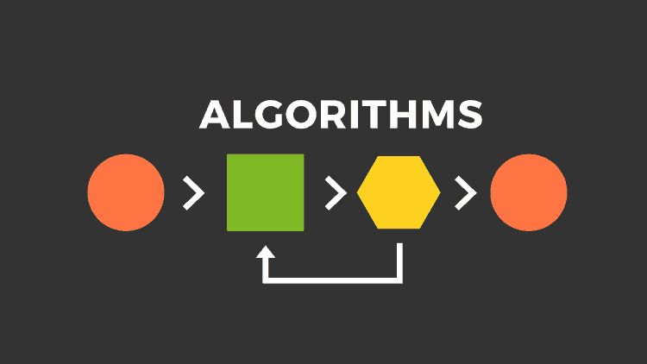
So, Here’s a Software… We all can use called Flowgorithm and this software helps us to see execution part of Algorithm as well helps us a lot to learn of course and here’s two problems are given to us.

Slide 10
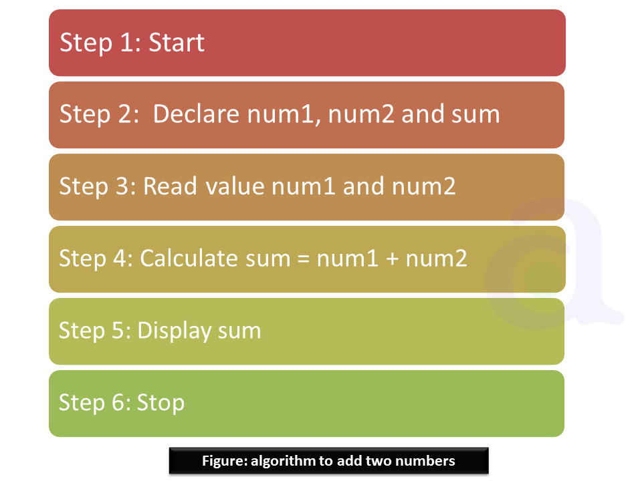
How to add two numbers in Algorithm

Slide 11

Advantages of Algorithms
1.It is a step-wise representation of a solution to a given problem, which makes it easy to understand.
2.An algorithm uses a definite procedure.
3. It is easy to understand for anyone even without programming knowledge.
4.By using algorithm, the problem is broken down into smaller pieces or steps

Slide 12

Disadvantages of Algorithms
>> Algorithms is Time consuming.
>> Big tasks are difficult to put in Algorithms.

Slide 13

Double click on speaker to get the audio.

